Slide 1
BINARY TREES!

Slide 2
Instructor
Dr. Ab Rouf Khan
Assistant Professor
VIT Bhopal University

Slide 3
Entry level Questions
How does Google sort the webpages while you are searching for some query?
How is hierarchical information stored in a database?
Can we perform sorting using Tree data structure?

Slide 4
Outline – Binary Trees
Binary Tree
Properties
Height, Number of Nodes, Fullness, Completeness, etc.
Traversals
Pre-order, In-order, and Post-order
Representations
Array & Linked List
Operations
Evaluate the arithmetic expression represented by a binary tree, Obtain the infix form of an expression.

Slide 5
Binary Tree (Recap)
Every node in a binary tree can have at most two children.
The two children of each node are called the left child and right child corresponding to their positions.
A node can have only a left child or only a right child or it can have no children at all.

Slide 6
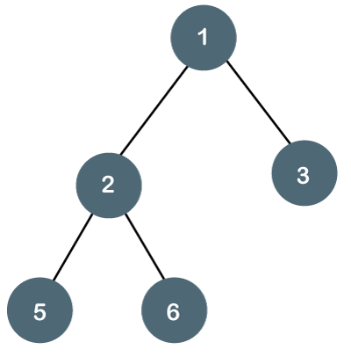
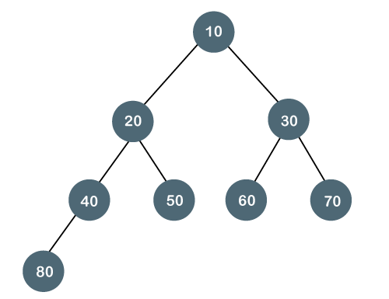
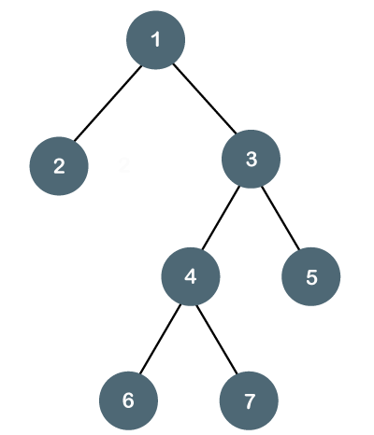
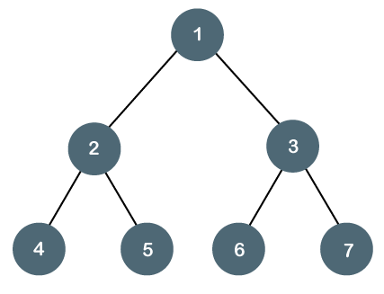
Binary Tree – Examples (Recap)

Slide 7
Minimum Number of Nodes
Minimum number of nodes in a binary tree whose height is h.
At least one node at each of first h levels.
minimum number of nodes is h

Slide 8
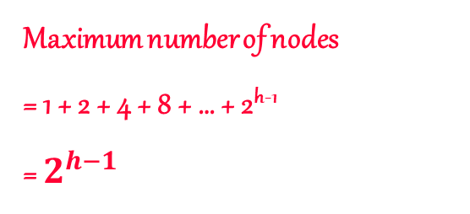
Maximum Number of Nodes
All possible nodes at first h levels are present.
Maximum number of nodes
= 1 + 2 + 4 + 8 + … + 2^{h-1}
= $2^{h−1}$

Slide 9
Number Of Nodes & Height
Let n be the number of nodes in a binary tree whose height is h.
h <= n <= 2^{h} – 1
log₂(n+1) <= h <= n

Slide 10
Fullness and Completeness
(In computer science) trees grow from the top down
New values inserted in new leaf nodes
A binary tree is full if all leaves are at the same level
In a full tree, every node has 0 or 2 non-null children
A binary tree is complete if:
All leaves are at level h or level h-1 (for some h)
All level h-1 leaves are to the left

Slide 11
Full Binary Tree
A full binary tree of a given height h has 2^{h} – 1 nodes.
Height 4 full binary tree.

Slide 12
Numbering Nodes In A Full Binary Tree
Number the nodes 1 through 2^{h} – 1.
Number by levels from top to bottom.
Within a level number from left to right.
1
2
3
4
5
6
7
8
9
10
11
12
13
14
15

Slide 13
Node Number Properties (1)
1
2
3
4
5
6
7
8
9
10
11
12
13
14
15
Parent of node i is node i / 2 (Quotient Part), unless i = 1.
Node 1 is the root and has no parent.

Slide 14
Node Number Properties (2)
1
2
3
4
5
6
7
8
9
10
11
12
13
14
15
Left child of node i is node 2i, unless 2i > n, where n is the number of nodes.
If 2i > n, node i has no left child.

Slide 15
Node Number Properties (3)
1
2
3
4
5
6
7
8
9
10
11
12
13
14
15
Right child of node i is node 2i+1, unless 2i+1 > n, where n is the number of nodes.
If 2i+1 > n, node i has no right child.

Slide 16
Complete Binary Trees
A complete binary tree is a special kind of binary tree which will be useful to us.
Let’s construct a
Binary Tree of states of India
When a complete
binary tree is built,
its first node must be
the root.

Slide 17
Complete Binary Trees
The second node of a complete binary tree is always the left child of the root...
India
J&K

Slide 18
Complete Binary Trees
The second node of a complete binary tree is always the left child of the root...
... and the third node is always the right child of the root.
India
J&K
MP

Slide 19
Complete Binary Trees
The next nodes must always fill the next level from left to right.

Slide 20
Complete Binary Trees
The next nodes must always fill the next level from left to right.

Slide 21
Complete Binary Trees
The next nodes must always fill the next level from left to right.

Slide 22
Complete Binary Trees
The next nodes must always fill the next level from left to right.

Slide 23
Complete Binary Trees
The next nodes must always fill the next level from left to right.

Slide 24
Complete Binary Trees
The next nodes must always fill the next level from left to right.

Slide 25
Is this a Complete Binary Tree?
NO!
Because Right Node of 4 is not filled yet.

Slide 26
Is this a Complete Binary Tree?
Because Right Node of 3 is not filled yet.
NO!

Slide 27
Is this a Complete Binary Tree?
NO!
Because Left child of root is not filled yet.

Slide 28
Is this a Complete Binary Tree?
YES!

Slide 29
Is this a Complete Binary Tree?
Yes!
It is called the empty tree, and it has no nodes, not even a root.
Notes:
This binary tree is also complete, although you might have to squint to see it. You see, this binary tree has no nodes at all. It is called the empty tree, and it is considered to be a complete binary tree.

Slide 30
Binary Tree Representation
Array representation.
Linked representation.

Slide 31
Array Representation
Number the nodes using the numbering scheme for a full binary tree. The node that is numbered i is stored in tree[i].
1
a
2
3
b
c
4
5
6
7
d
e
f
g
8
9
10
h
i
j
tree[]
a
b
c
d
e
f
g
h
i
j
0
5
10

Slide 32
Right-Skewed Binary Tree
1
a
b
3
7
c
15
d
tree[]
a
-
b
-
-
-
c
-
-
-
-
-
-
-
d
0
5
10
15
An n node binary tree needs an array whose length is between n+1 and 2^{n}.

Slide 33
Linked Representation
Each binary tree node is represented as an object whose data type is BinaryTreeNode.
The space required by an n node binary tree is n * (space required by one node).
Notes:
Notice that a linked representation always take space that is linear in the number of elements in the tree. An array representation may take an exponential amount of space!

Slide 34
The Class BinaryTreeNode
package dataStructures;
public class BinaryTreeNode
{
Object element;
BinaryTreeNode leftChild; // left subtree
BinaryTreeNode rightChild;// right subtree
// constructors and any other methods
// come here
}

Slide 35
Linked Representation
root
a
b
c
e
d
g
f
leftChild
element
h
rightChild

Slide 36

Recap

Slide 37
Thank You

